Slide 1
Chinese
Indian
Steakhouse
Town
DinnerParty
State
Restaurant
Event
Place
Country
Pasta
Generates
Rates
livesIn
Person
City
Posts
SeaFood
hasFavorite
Food
Media Content
Picture
Fruit
Super Classes
Comment
Fowl
Desert
Sub Classes
Video

Slide 2
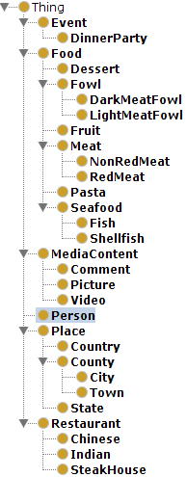
Top Level
Middle Level
Bottom Level
Middle Level
Top Level
Bottom Level

Slide 3
Food
Sirloin Steak
Kind Of
Is A
Meat (Major Classification of food)
Red Meat
Kind Of
Is A
Red Meat (type of meat)
Meat
Kind Of
Is A
Sirloin Steak (Specific Meat)
Food
Top down approach
Bottom up approach

